Slide 1
Line following robot for
GETTING OUT MAZE and
FINDING OPTIMAL PATH support
INDOOR LOCALIZATION and
NAVIGATION
Hoang The Hop – Tran Xuan Tuyen – Doan Manh Duy
Research advisor: DR. Nguyen Thi Thanh Van

Slide 2
Table of content
1
Hardware specify and system design
2
PID controller design
Implemented based on theoretical and practical approach
3
Path-finding algorithm
Shorting the way out of maze to get the optimal path
4
Filter applied in our sensor
A comparison between complementary and Kalman filter is illustrated
5
Android app for users controlling
5

Slide 3
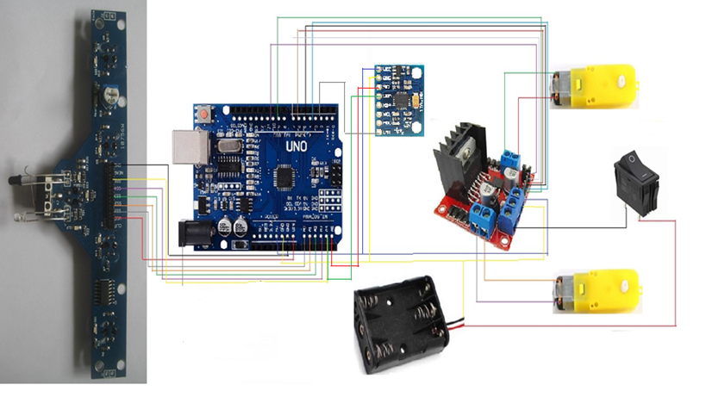
System overview

Slide 4
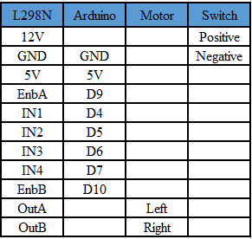
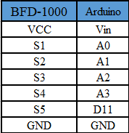
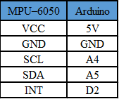
Connection diagram

Slide 5
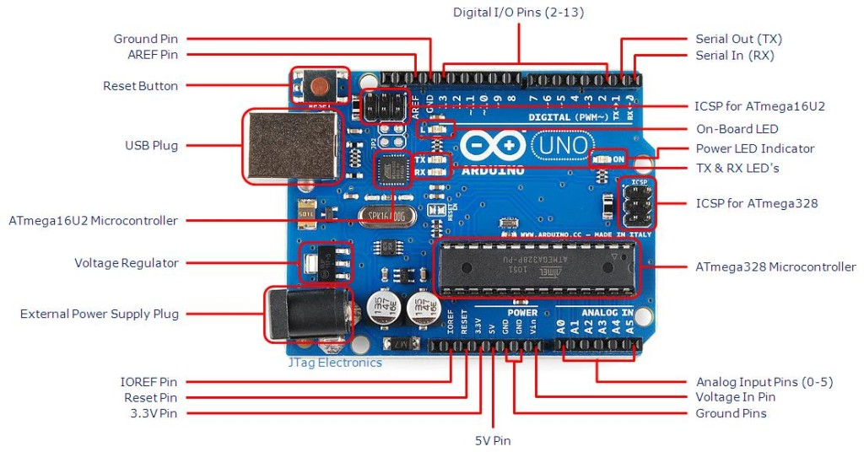
Preparation parts
1. Arduino UNO R3 ( central controller )
Main controller: ATmega328
Power supply: 5VDC from USB or external DC plug
Number of pins Digital: 14 (supports 6 pins PWM)
Analog pins: 6
Max output on GPIO: 40mA
Max output power 3.3VDC: 150mA
Flash memory capacity: 32kB
SRAM: 2KB
EEPROM: 1KB

Slide 6
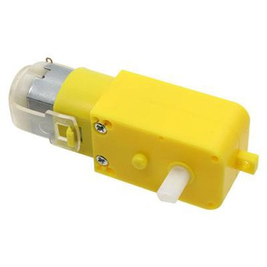
2. Motor + Wheel
2 rear wheel mounted engine with encoder
1 driven wheel

Slide 7
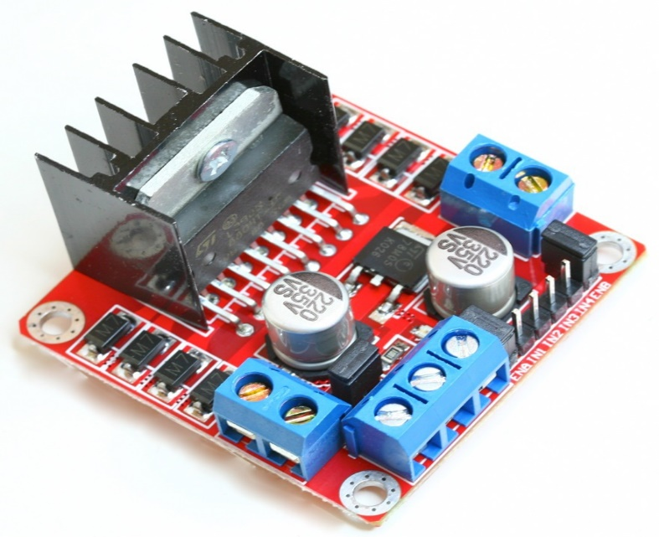
3. L298N
The Motor Driver uses an L298N H-bridge to control the speed and direction of the DC motor easily
Driver: L298N integrates two
H bridges
Control voltage: 5 V ~ 12V
Max current for each bridge H: 2A
Control signal voltage: 5 V ~ 7 V
Control signal current: 0 ~ 36mA

Slide 8
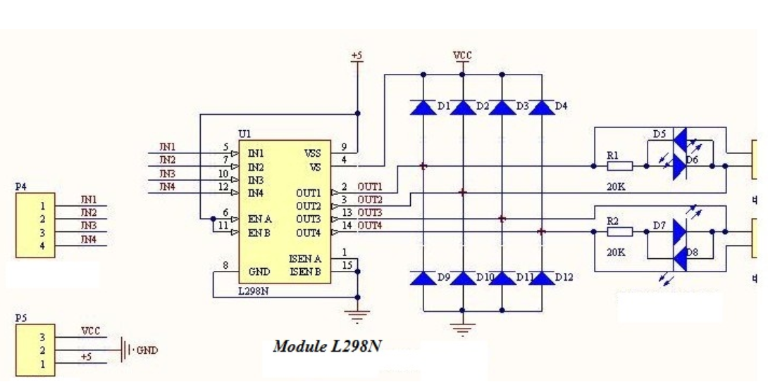
Operational principle

Slide 9
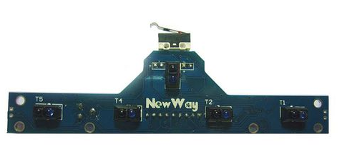
4. BFD-1000
Operating voltage: 3.3 ~ 5VDC
Having LED to display output for each sensor
Output has 7 signal pins of the digital sensor and 2 inputs supply power to the device
Distance detection: 1 ~ 2.5cm
Size: 128 x 45 x 12mm

Slide 10
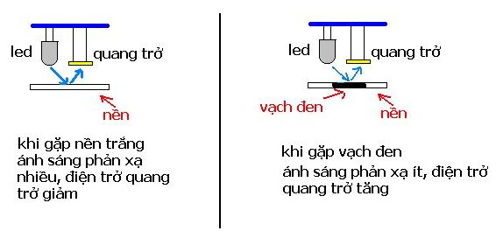
Including 5 infrared sensors, which help the car to grip the road..

Slide 11
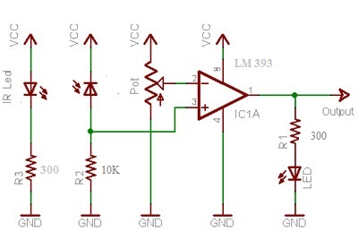
Operational principle

Slide 12
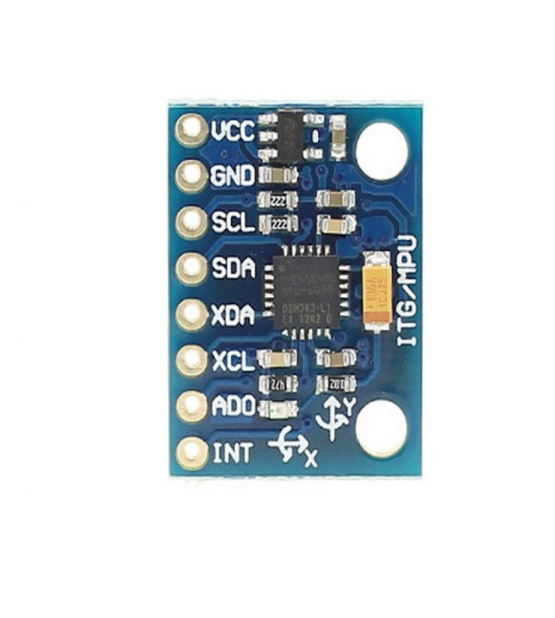
5. MPU-6050
The MPU-6050 accelerometer sensor GY-521 integrates 3-axis accelerator + 3-axis gyroscope to control the balance or direction of motion for robots
Chip: MPU-6050 (16bit ADC, 16bit data out)
Gyroscopes in range: +/- 250 500 1000 2000 degree / sec
Acceleration value: +/- 2g, +/- 4g, +/- 8g, +/- 16g
Communication: I2C
Power supply: 3V - 5V (DC)

Slide 13
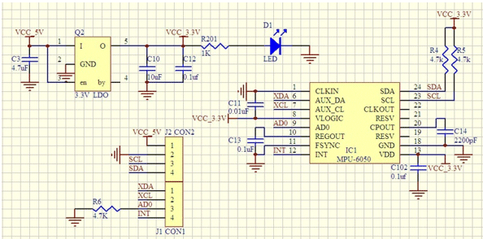
Operational principle

Slide 14
6. DC Power: using 3 pins ( each pin supplies 3.7V )
7. Mica table
8. Wire
…

Slide 15
PID Controller design
Theoretical approach: have not resulted in good performance
Practical approach: Applying Ziegler - Nichols method

Slide 16
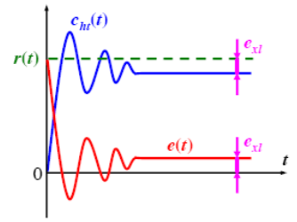
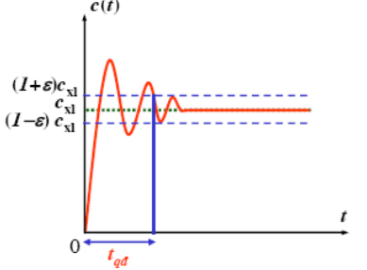
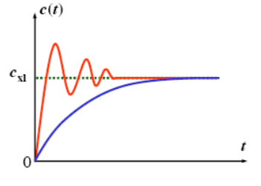
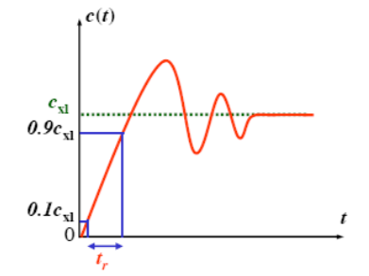
System criteria evaluation
Steady-state error
Percent of Overshoot
Setting time
Rise time

Slide 17
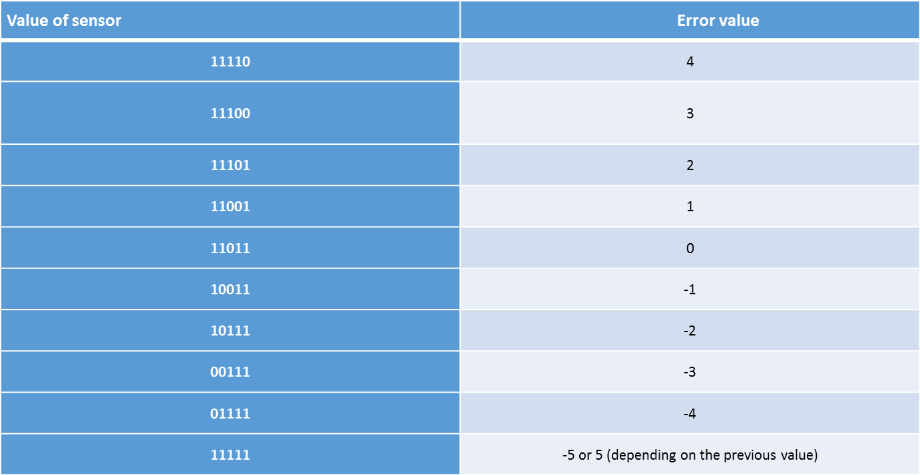
Practical approach:
Mapping sensor value with corresponse error

Slide 18
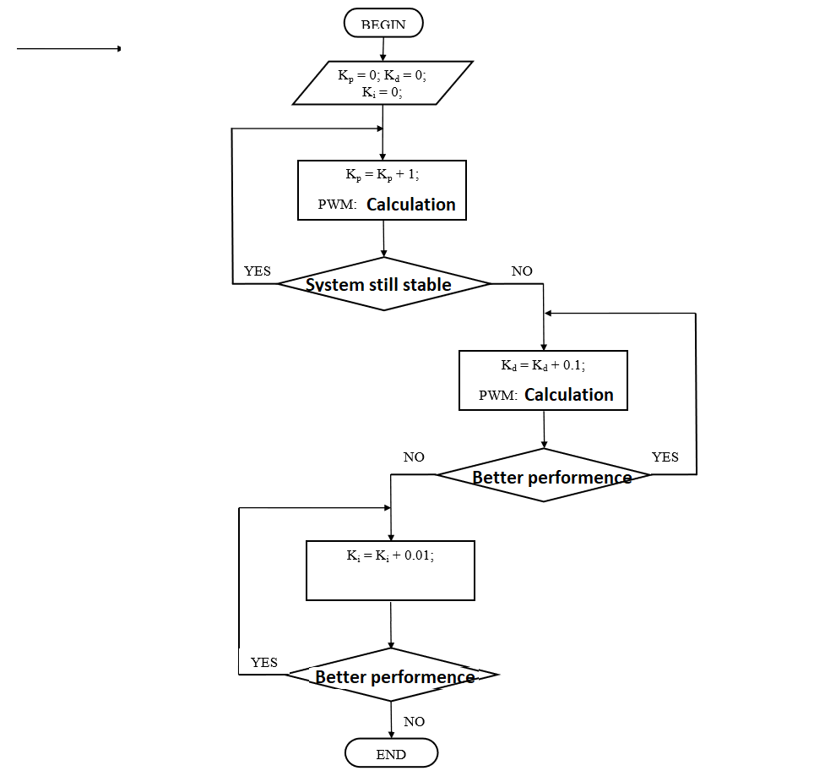
PID Tuning algorithm: Based on Ziegler–Nichols method

Slide 19
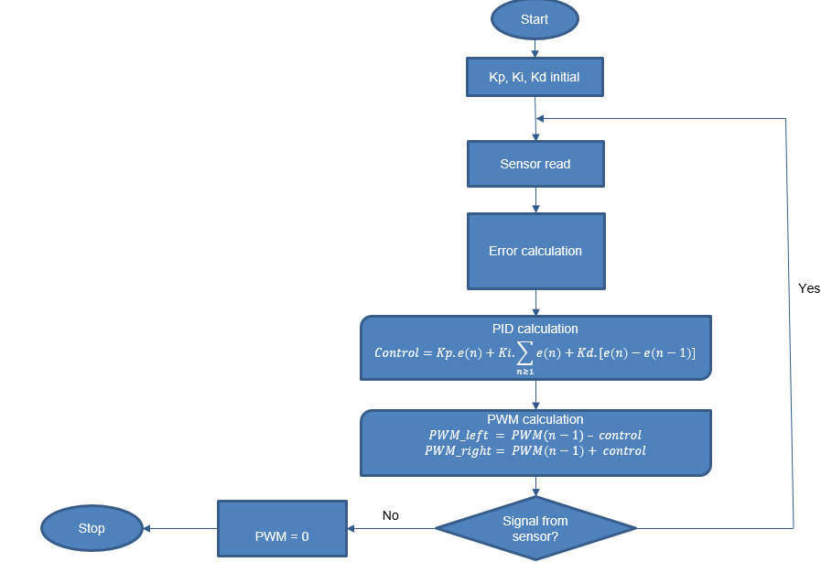
Control algorithm

Slide 20
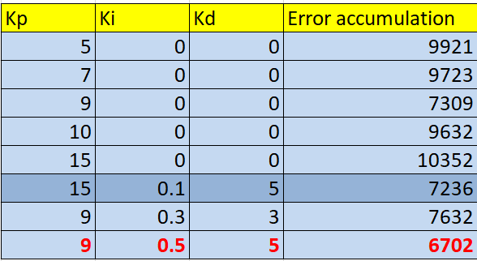
The Kp, Ki, Kd selection

Slide 21
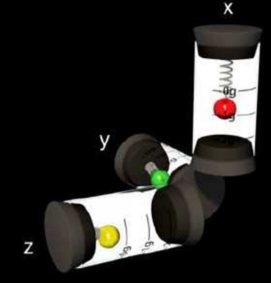
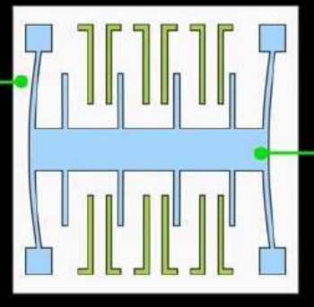
Accelerometer
MEMS Technology

Slide 22
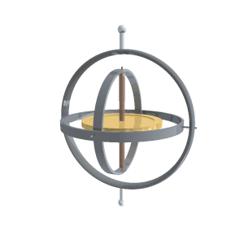
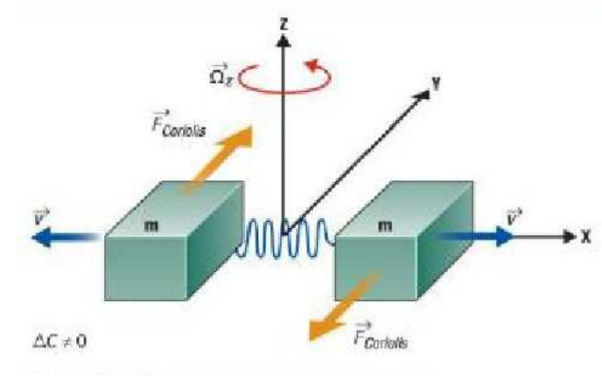
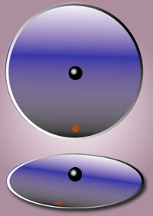
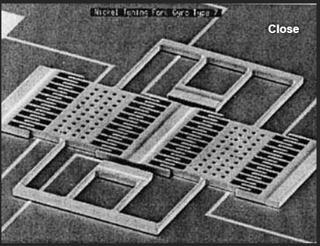
Gyroscope
Based on Corilis rule

Slide 23
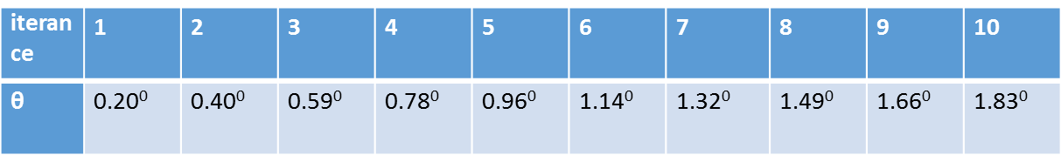
Complementary filter
A combination of low-pass filter and high-pass filter
Low-pass filter:
High-pass filter:

Slide 24
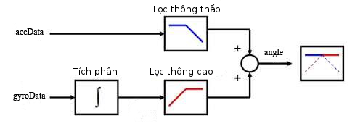
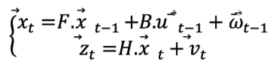
Filter applied in our system
Complementary filter:
Kalman filter:

Slide 25
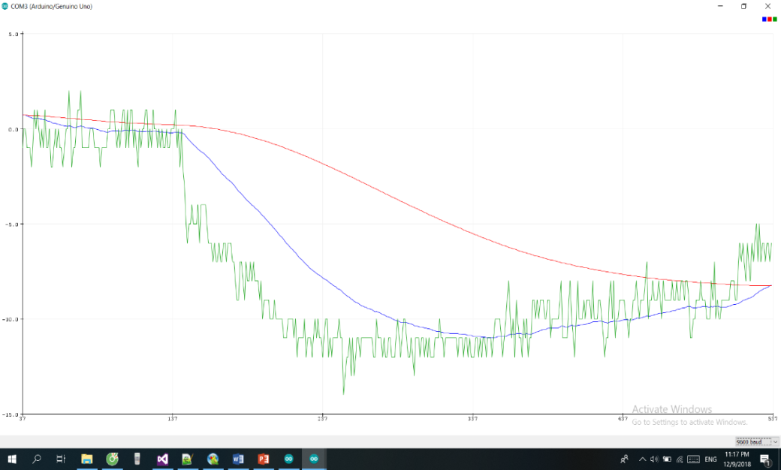
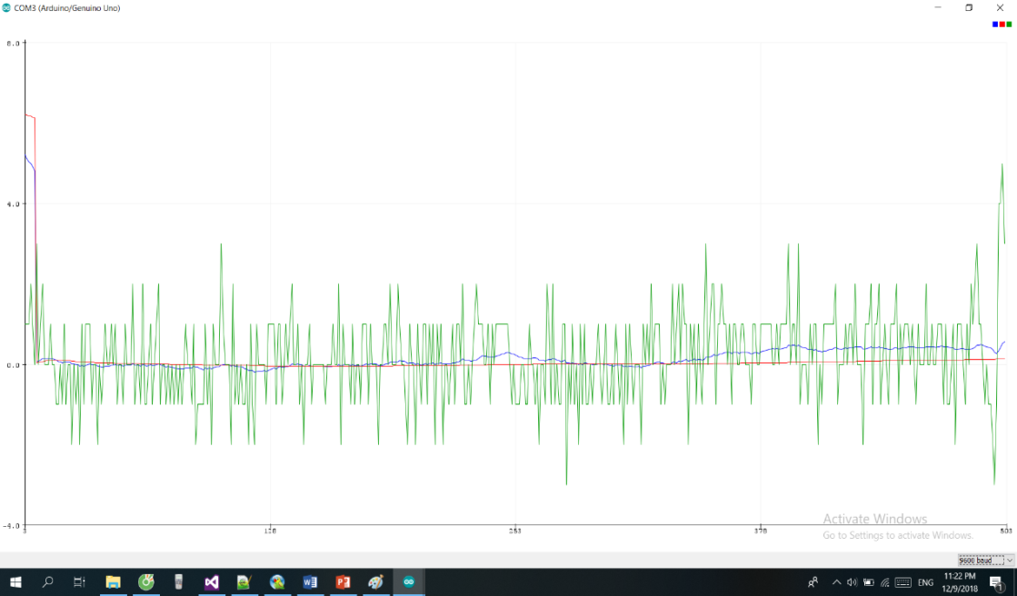
Result
Raw data:
Complementary filter
Kalman filter

Slide 26
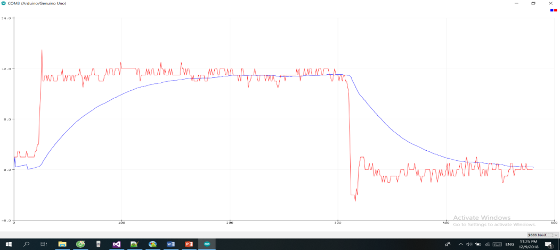

Slide 27
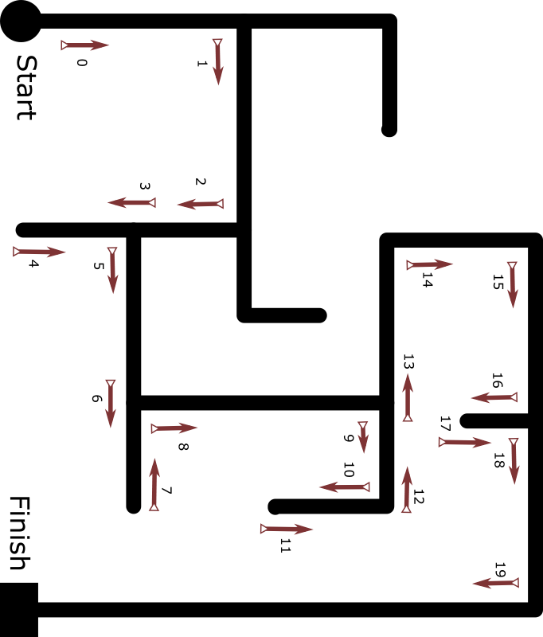
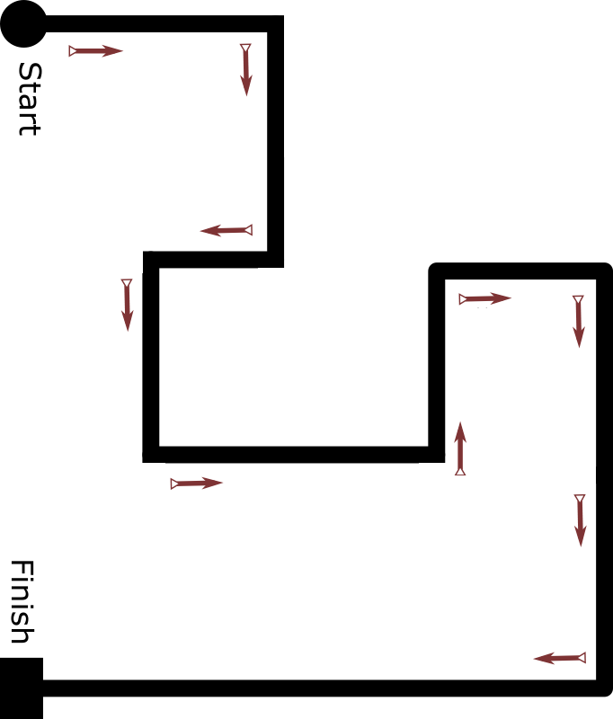
Finding path rule
Finding path target
Left hand always touch to the wall of maze.
Find the way out of maze.
Smart
Robot
Optimal path rule
Optimal path target
Use a table of triad reduction.
Reduce all the redundant action and store the correct path

Slide 28
Table Style
 | Action[n-3] | Action[n-2] | Action[n-1] | Corresponding Action
Case 1 | L | B | R | B
Case 2 | L | B | S | R
Case 3 | R | B | L | B
Case 4 | S | B | L | R
Case 5 | S | B | S | B
Case 6 | L | B | L | S
List of triad reduction

Slide 29
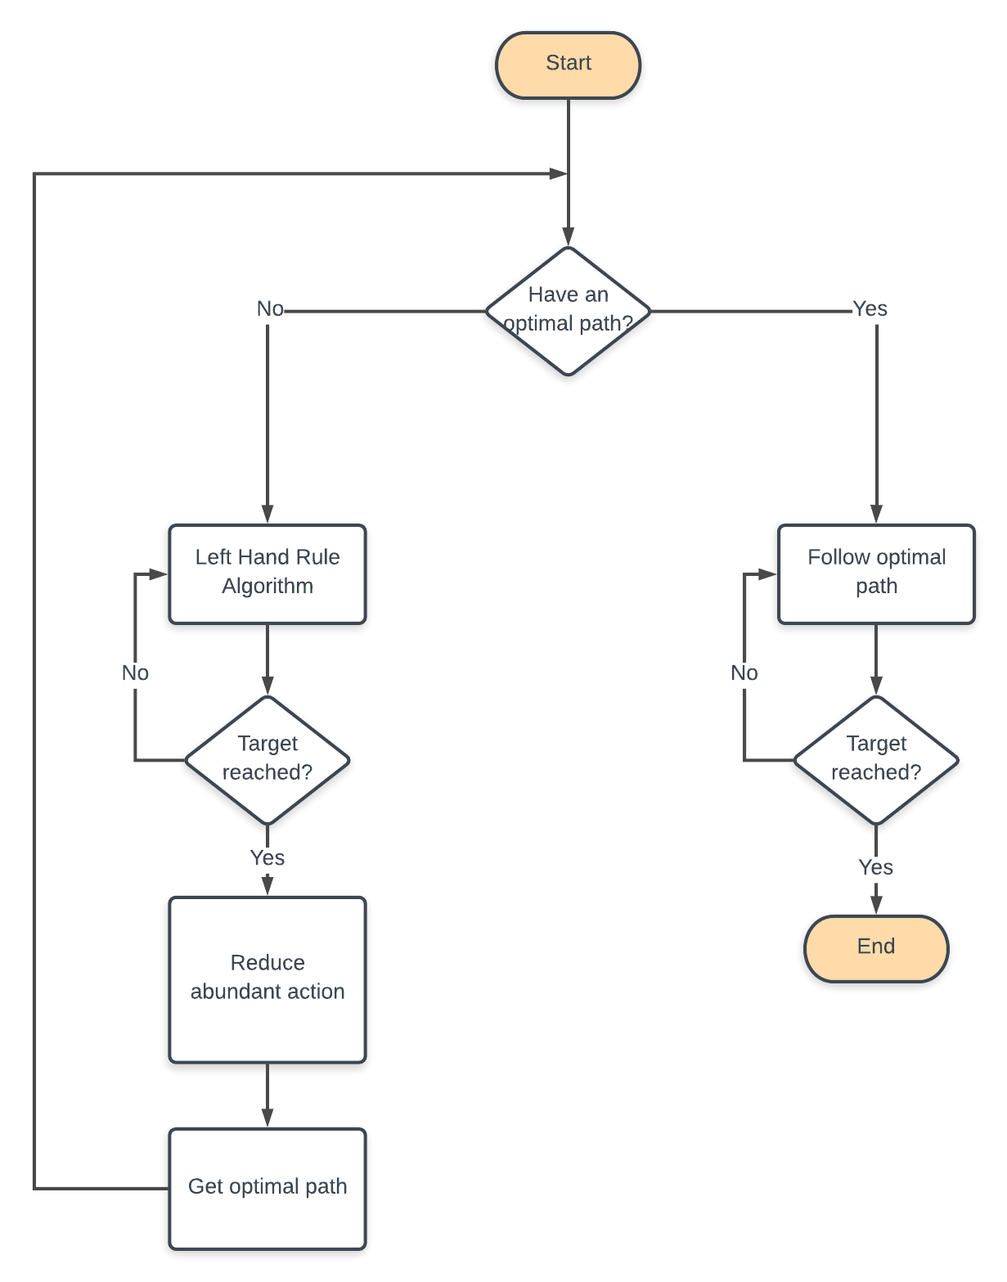
Algorithm flow chart

Slide 30
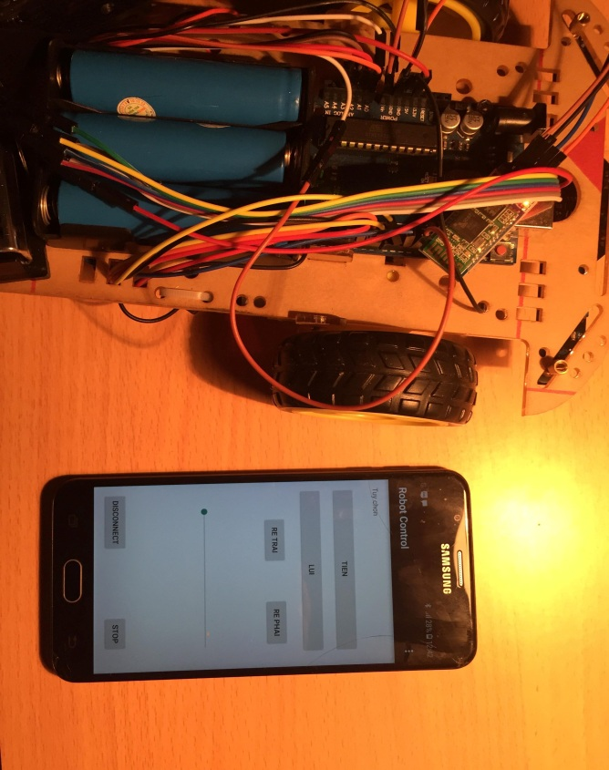
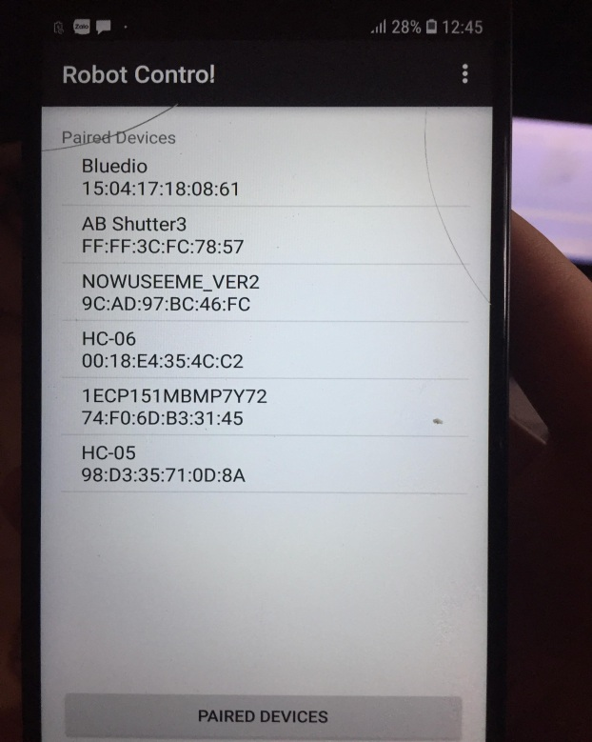
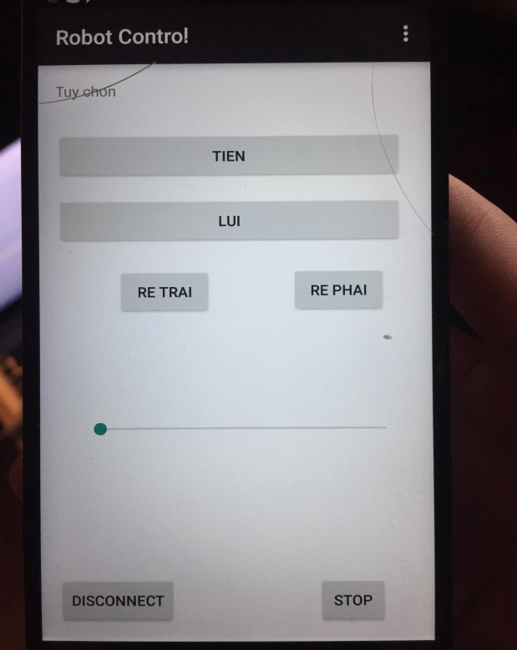
Android app for user control

Slide 31
Thank you

